Slide 1
Capstone Project 1 BIGDATA ENGINEERING
by
Subham Shit

Slide 2

Business Objectives
Basic Exploratory Analysis on different metrics available to get insights at the Employee level as well as Department levels.
To analysis the various factors connected to the Employee’s Leaving and improve on those parameters viz Salary, Last Performance Ratings, Years of Service (Tenure), No of projects etc.
Technology-wise Objective : Creating an End-to-End Pipeline to enhance the automation to do quick analysis and manage all the repetitive actions in a proper-structured manner.

Slide 3

Data Description
This dataset has total 6 tables (Records) –
Employees (300024),
Salaries (300024),
Titles (7),
Dept_Emp (331603 -> 300024),
Dept_Manager (24) and
Departments (9).

Slide 4
Data Description
Titles (titles.csv):
title_id – Unique id of type of employee (designation id) – Character – Not Null
title – Designation – Character – Not Null
Employees (employees.csv):
emp_no – Employee Id – Integer – Not Null
emp_titles_id – designation id – Not Null
birth_date – Date of Birth – Date Time – Not Null
first_name – First Name – Character – Not Null
last_name – Last Name – Character – Not Null
sex – Gender – Character – Not Null
hire_date – Employee Hire date –Date Time -Not Null
no_of_projects – Number of projects worked on – Integer – Not Null
Last_performance_rating – Last year performance rating – Character – Not Null
left – Employee left the organization – Boolean – Not Null
Last_date - Last date of employment (Exit Date) – Date Time
Salaries (salaries.csv):
emp_no – Employee id – Integer – Not Null
Salary – Employee’s Salary – Integer – Not Null
Departments (departments.csv)
dept_no - Unique id for each department – character – Not Null
dept_name – Department Name – Character – Not Null
Department Managers (dept_manager.csv)
dept_no - Unique id for each department – character – Not Null
emp_no – Employee number (head of the department ) – Integer – Not Null
Department Employees (dept_emp.csv)
emp_no – Employee id – Integer – Not Null
dept_no - Unique id for each department – character – Not Null

Slide 5











Technology Stack
Linux Commands (to run the bash script)
MySQL (to create database - RDBMS)
Sqoop (Transfer data from MySQL Server to HDFS/Hive)
HDFS (to store the data)
Hive (to create database)
Impala (to perform the EDA)
SparkSQL & PySpark (to perform the EDA)
SparkML (to perform model building)
git (for version control)

Slide 6
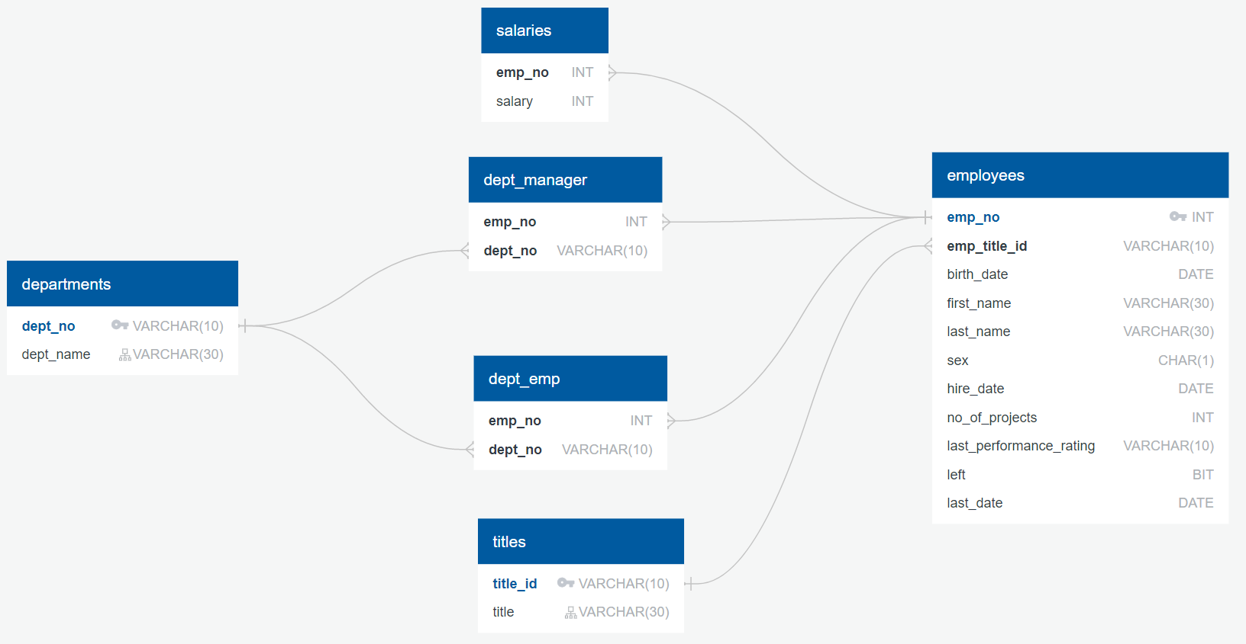
ER Diagram

Slide 7
Architecture of pipeline
capstone.py
.csv
sqoop
HiveDB.hql
EDA.sql
Capstone.ipynb
CreateMySQLTables.sql
1. Loading Data [.csv files]
2. Creating MySQL Tables & Inserting Data
3. Transferring Data + Metadata from MySQL to HDFS Warehouse Using sqoop
4. Creating Hive Tables
5. Performing EDA in Impala
6. Performing EDA with Spark SQL
7. Building RF Classifier Model and Logistic Regression Model with Spark ML
Cap_MySQLTables.txt
HiveTables.sql
Cap_SparkSQL_EDA_ML.txt
Cap_ImpalaAnalysis.txt
Cap_HiveDB.txt
random_forest.model.zip
logistic_regression.model.zip
Cap_HiveTables.txt

Slide 8
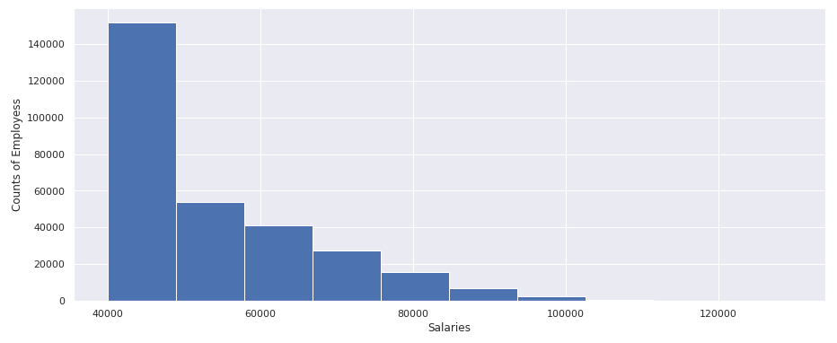
Outputs
Histogram to show the salary distribution among the employees

Slide 9
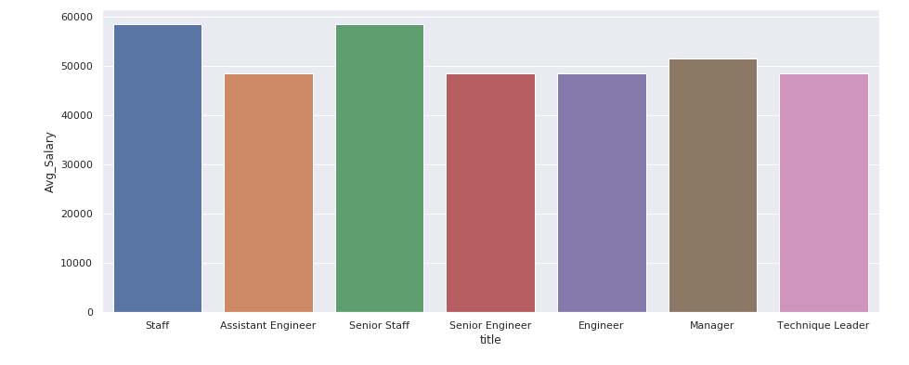
Outputs
Bar graph to show the Average salary per title (designation)

Slide 10
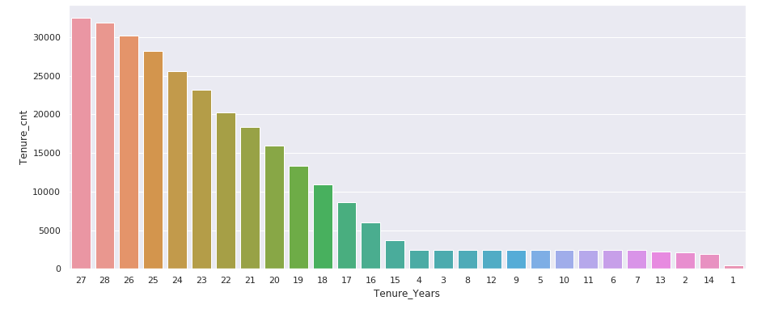
Outputs
Calculate employee tenure & show the tenure distribution among the employees

Slide 11
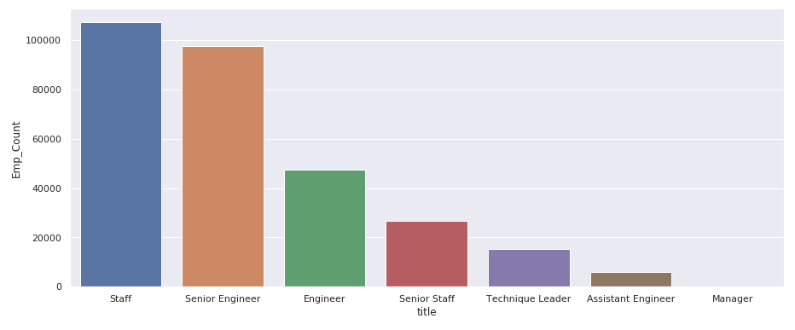
Outputs
Distribution of Employees across various titles

Slide 12
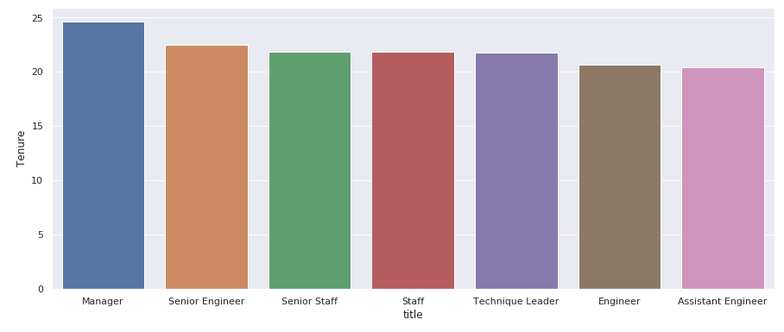
Outputs
Average Tenure Distribution across Titles

Slide 13
ML Model Parameters
Random Forest Classifier Model
Accuracy = 0.9980555834925744
Error = 0.001944416507425606
Precision = 0.9980594815941188
Recall = 0.9980555834925743
F1 = 0.9980471469145747
Logistic Regression Model
Accuracy = 0.9004101154357617
Error = 0.09958988456423834
Precision = 0.8107383759790415
Recall = 0.9004101154357617
F1 = 0.8532246480840692

Slide 14

Challenges Faced
Importing data using SQOOP to HDFS (--m 1 argument added)
Creating the Hive Avro Tables – Merging Data & Metadata
Fetching the Hive tables in Spark (Jupyter Notebook Environment)
Creating ML Pipeline as OneHotEncoding does not contain fit method in Spark 2.4.0

Slide 15

Next steps
Modifying / Upgrading of Working Policies Focusing on the Employee Retention.
Fixing the Issues related to the Appraisals / Ratings, Salaries etc. so that probability of loosing a valuable employee can be reduced.
Using the current model further analysis can be done with newly updated employee records to understand employee sentiments.

